Slide 1

Machine learning final assessment:
Loan Interest Rate Prediction
Group members
Kowsalya solleti
Ajay nalla
Guthula Somanadh
Gangadhara neelam
Kaushik adiraju
Kajuluri naveen
Thiresh sidda

Slide 2

Business Objective, Understanding and Approach
Business Objective
Understanding
Business Objective
Understanding
A company is in the financial lending business. It provides loans to retail customers. It collects the information about the customers and analyzes it manually whether the customer is eligible or not. If the customer is eligible at what interest rate to be given to the requested loan is analyzed.
Going forward the company, the company wants to employ an automated process that is based on a machine learning model. Not only is this model expected to make the decision process faster, but also keeping it free from human error and biases
We are given a data set which contains the information of the customers applied for loan
Based on the information given ,useful insights must be taken
The analysis should define which features are affecting the target variable
Target variable observed to be interest rate
An automated model need to be developed using the data set ,so that it predicts the target variable ,interest rate using the applied inputs
Approach
At first the preprocessing techniques need to performed on the data set which includes cleaning the data ,handling missing values and outliers
The next step includes visualization of the features and drawing useful insights from the data
We have to perform some key analysis from the data and find out relations of independent features with target feature
As it is multiclassification problem we chose decision tree classifier as the algorithm to develop the model

Slide 3
Analysis/ Modeling Methodology
Data Preparation & EDA
Variable Creation and Selection
Model Development
Model Performance Testing
Sub-setting is done by removing Loan_ID , Home owner
All the missing values have been replaced with corresponding mean or mode
Extensive bi-variate analysis conducted on all meaningful variables
20+ new variables created as a part of feature engineering
Used label encoding to create dummy variables
Used mapping techniques to map the object variables to numerical variables
Decision tree classifier chosen as the preferred modeling technique since the target variable is multiclass and data is complex
Developed 5+ candidate models
Highest Model accuracy observed of 74%
Conducted k-cross validation for k=5,10,15
Model performance also assessed on a hold-out sample of size 20% of the original dataset
Performed all the required metrics precision ,recall, confusion matrix ,roc_auc curve

Slide 4
Extended Data Dictionary (EDD)
Variable Name | Variable Type | Min | Pc 1% | Pc 5% | Pc 25% | Pc 50% | Mean | Pc 75% | Pc 95% | Pc 99% | Max | % Missing values | % Unique values
Loan amount requested | numeric | 500 | 1800 | 3500 | 8000 | 12075 | 14351 | 20000 | 30000 | 35000 | 35000 | _ | 0.78
Employmentduration | numeric | 1 | 1 | 1 | 5 | 7 | 11 | 11 | 11 | 11 | 11 | 4 | 0.007
Annual Income | numeric | 4000 | 19000 | 28000 | 45000 | 63000 | 73331 | 88698 | 150000 | 240000 | 7500000 | 15 | 7.4
Inquries last 6 months | numeric | 0 | 0 | 0 | 0 | 0 | 1 | 1 | 3 | 4 | 8 | _ | 0.005
Deliquency months | numeric | 0 | 1 | 5 | 16 | 31 | 34 | 50 | 74 | 80 | 180 | 54 | 0.074
Active accounts | numeric | 0 | 3 | 5 | 8 | 10 | 11 | 14 | 20 | 27 | 76 | _ | 0.035
Total accounts | numeric | 2 | 6 | 9 | 17 | 23 | 25 | 32 | 47 | 59 | 156 | _ | 0.061
Debt to Income ratio | numeric | 0 | 2 | 5 | 11 | 17 | 8 | 23 | 31 | 35 | 40 | _ | 2.406
Home Ownership | categorical | _ | _ | _ | _ | _ | _ | _ | _ | _ | _ | 15 | 0.003

Slide 5
Findings from EDD :
It is observed that maximum customers are requesting for the loan less than 36000/-
It is observed that large number of customers are employed for more than 10 years
99% of customers are having annual income less than 2,40,000. An outlier is being identified
More number of missing values have been identified in annual income
It is observed that 99 per customers have been inquired for less than 4 times
Total debts of the customers is very high
Months since deliquency is having more than 54 per of missing values
Home ownership is having 15 per of missing values

Slide 6
Feature Engineering – New variables created
Sr. No | Variable Name | Variable Type | Description
1 | Rent ,own | Object | We created dummies using home ownership where new complementary features are created
2 | Total debt | Numeric | Using variables annual income and income to debt ratio we created new feature total debt
3 | Length employed | Numeric | Using label encoding we converted categorical values into numerical
4 | Amount requested | numeric | Using the loan amount requested we created bins and assigned to amount requested
5 | Purpose of loan | Object | All the categorical features have been encoded to numerical features

Slide 7
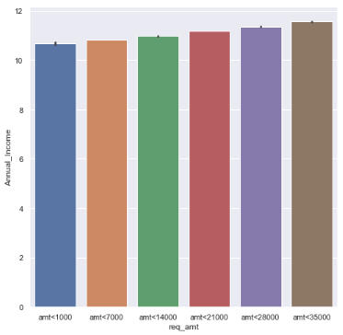
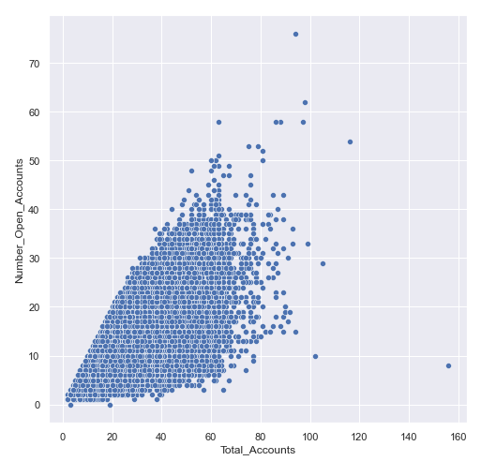
Analysis Results
Requested loan amount vs Annual income
Total accounts vs number of active accounts
Key Findings :
1.The customers with high annual income are taking more amount of loan
2.The loan amount varies in between 1000/- to
35000/-
Key Findings :
1.The customers with more number of accounts are still maintaining active accounts
2.It is observed that the total accounts is closely related to active accounts

Slide 8
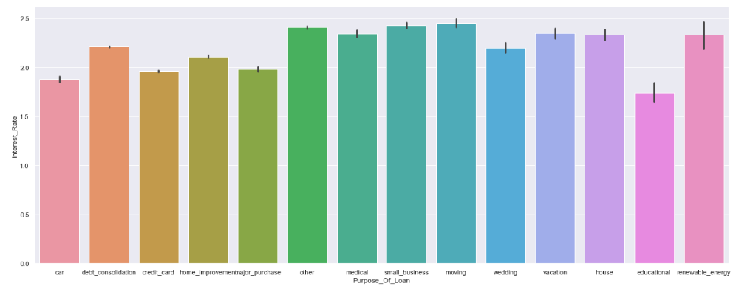
Exploratory data analysis w.r.t dependent variable
Purpose of loan
Key Findings :
Customers who are opting for education loan are charged low interest rates
Customers opting for credit card loans are charged low interest rates
Customers with credit line as moving and other are charged high interest rates
Customers who are taking loans to consolidate their debts are charged heavy interests

Slide 9
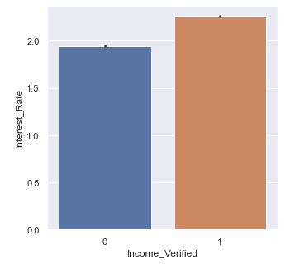
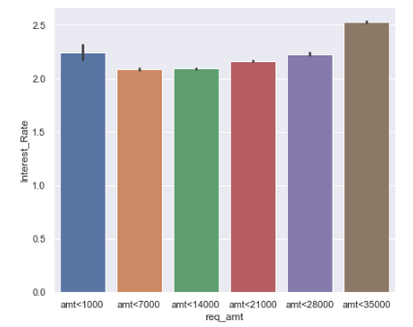
Income verified
Requested loan amount
Key Findings :
1.Customers whose source of income is verified are charged high interest rates
Key Findings :
1.Customers who are taking more amount of loan are charged high interest rates
2.Customers taking very less amount below 1000/- are also charged high interest rates

Slide 10
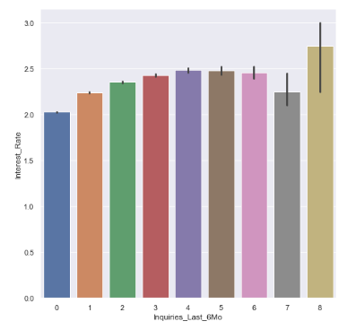
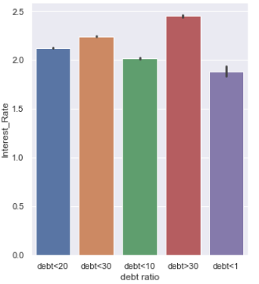
Inquiries since last 6months
Ratio of debt to income
Key Findings :
1.Customers who were charged high interest rates are inquired more number of times since last 6 months
Key Findings :
1.Based on ratio of debt to income ,interest rates are being charged more for customers with high debt to income ratio

Slide 11
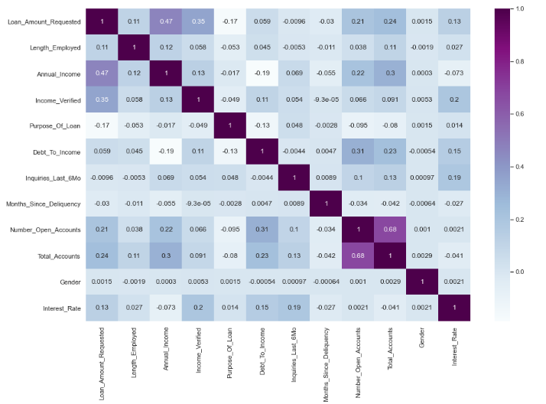
Correlation matrix
Key Findings:
1.Total accounts and active accounts are highly correlated with correlation>0.67
2.Requested loan amount ,verified income ,debt to income , inquiries last 6months are the features having comparatively good correlation with interest rate

Slide 12
Model development and performance:
Based on the problem statement we need to develop a decision tree classifier model on the data set provided
After data pre-processing the dataset is divided into 80% and 20% split in which 80% of records of dataset are used as training dataset to build the model and 20% of records dataset is used as testing dataset to test the accuracy of prediction of the model
We performed decision tree classification after training the model
We obtained the Gini value for the root node using all the categorical variables as : 0.64
In the model building we observed few problems such as
overfitting
class imbalance
Final model –
Accuracy:75
Precision:77
Recall:74
F1score:76
Cross validation:
For the further validation, Cross Validation technique is used with k-Fold values 10,15, and 20
The average score that is obtained is turned out to be around 62

Slide 13
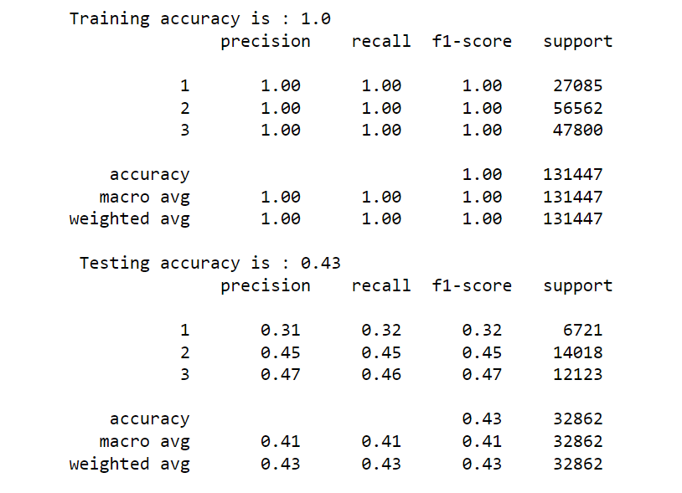
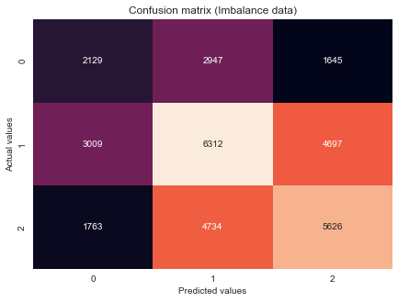
Model1 (for raw unpruned data)
It is observed that the training accuracy of model is very high when compared to testing accuracy
So the model completely fits the training data but fails to generalize the testing unseen data
Precision and recall scores are also found to be very low

Slide 14
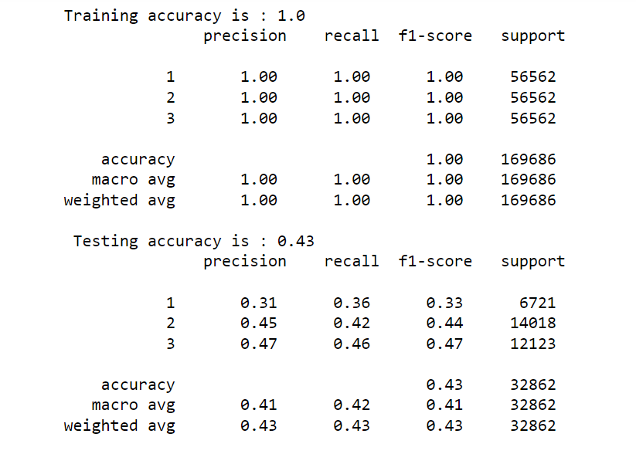
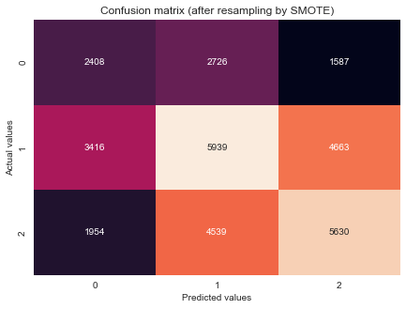
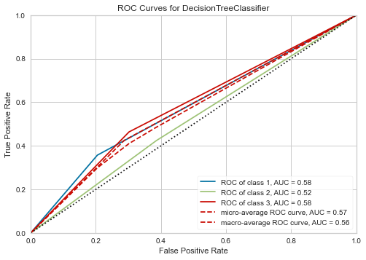
Model 2 (using smote)
Our data has class imbalance ,so we performed few of the sampling techniques out of which we got better metrics through SMOTE
The data is imbalanced ,So data was resampled by using SMOTE technique
It aims to balance class distribution by randomly increasing minority class examples by replicating them
SMOTE synthesis new minority instances between existing minority instances.

Slide 15
Decision boundaries:
loan amount requested <=200037.5
annual income <=11.288
debt to income<=16.595
income verified<=0.5
gender<=0.5
length employed<=5.5
Purpose of loan<=3.5
Months since delinquency<=34.5
As our model is overfitting we performed pruning the previous model
Since the dataset is complex we got hyperparameters using grid search cv
Hyperparameters:
Criterion :Gini
The minimum number of samples required to split an internal node are 10.
The minimum number of samples required to be at a leaf node are 49.
The maximum depth of the tree is 9

Slide 16
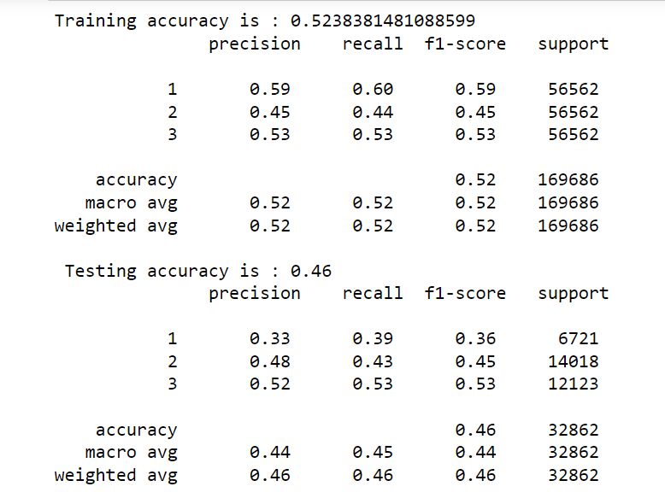
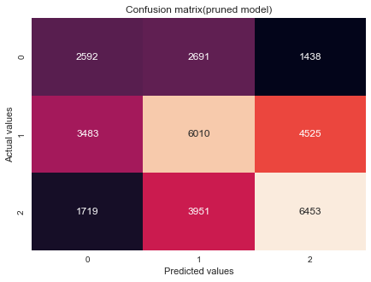
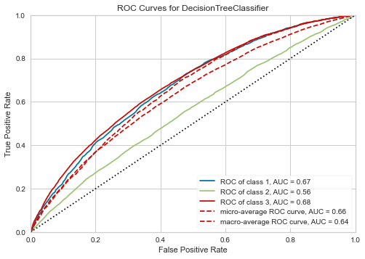
Model 3 (after pruning)
Final model –
Accuracy:46
Precision:48
Recall:43
F1score:45
Cross validation score:46

Slide 17
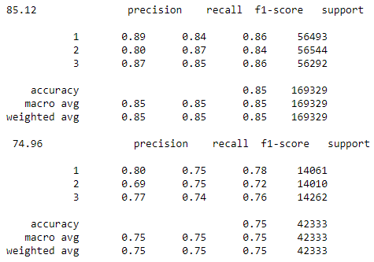
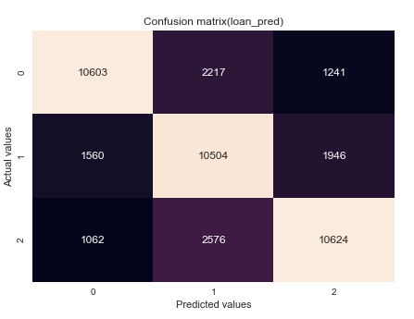
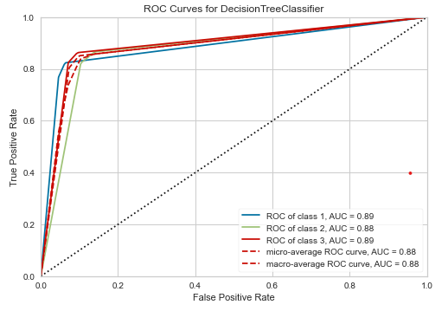
Final model(using oversampling):
We trained the model using only the correlated features in the training data they are -----> loan amount requested , purpose of loan, debt to income ,income verified ,inquiries last 6months
We are getting the best accuracy with this model.
Final model –
Accuracy:75
Precision:77
Recall:74
F1score:76
Cross validation score:62

Slide 18
Client/End-user needs
The technical requirements that the client need to meet are Python with numpy ,pandas, matplotlib, seaborn and sk_learn libraries.
The files which are needed for the client are Model Data, Code file(Jupyter Notebook) and presentation report.
The client needs to drop the irrelevant features initially and then new features must be derived from the features with uncleaned data.
The client can know that the model is performing well on new data points by checking the accuracy on test data.
Model performance using different algorithms
Accuracy:
Random forest:47
KNN:37
Logistic regression:47

Slide 19
Key Takeaways and Recommendations
Feature | Interest Rate “1” | Interest Rate “2” | Interest Rate “3”
Average Loan Amount | 13,351 | 13,419 | 16007
Duration | 10 | 10 | 10
Home Owner | Mortgage | Mortgage | Mortgage
Annual Income | 80000 | 70000 | 70000
Purpose Of Loan | Debt Consolidation | Debt Consolidation | Debt Consolidation
Debt To Income | 15 | 17 | 18
Inquiries | 0 | 0.7 | 1
Days Since Deliquency | 36 | 34 | 33
Number of Open Accounts | 11 | 11 | 11
Total Accounts | 26 | 24 | 24
Gender | Male | Male | Male
Income Verification | Verified | Verified | Verified
Due to this much of bias in the data the model is unable to calculate the interest rate with high accuracy
This would be a big problem if a safe customer gets an high interest rate as he also have another options
This will be directly impacting the growth of the firm
In order to tackle this situation we as a team came up with an approach of solving this problem

Slide 20
We have took some conditions by using our financial senses and sources from the internet.
They are:
Debt_To_Income<=25
Inquiries_Last_6Mo<=1
Income_Verified='verified'
Months_Since_Deliquency<=30
Home_Owner='own' or ‘Rent’
Length_Employed=10+ years
Purpose_Of_Loan= all except 'debt_consolidation'
We have assigned Interest rate for all the customers who are satisfying these conditions as ‘1’
We call them as ‘Safe Customers’

Slide 21
When We trained a model by taking these two conditions, even though there are 2100 records the Algorithm has classified them clearly.
But when we replaced the records with the previous records, because of the data bias we got an accuracy of 45% without pruning.
The conditions we took here are of our knowledge but the client may have a different approach.
Coming to the deployment side the client must have some certain conditions on the basis of which the Interest Rate is assigned.
We suggest the client to give us some conditions based on which we can reiterate through the whole data and can change some of it.
Changing the data and classifying the interest rates correctly to the customers may have an effect on model accuracy and client can happily deploy it on his side.

Slide 22


